Slide 1
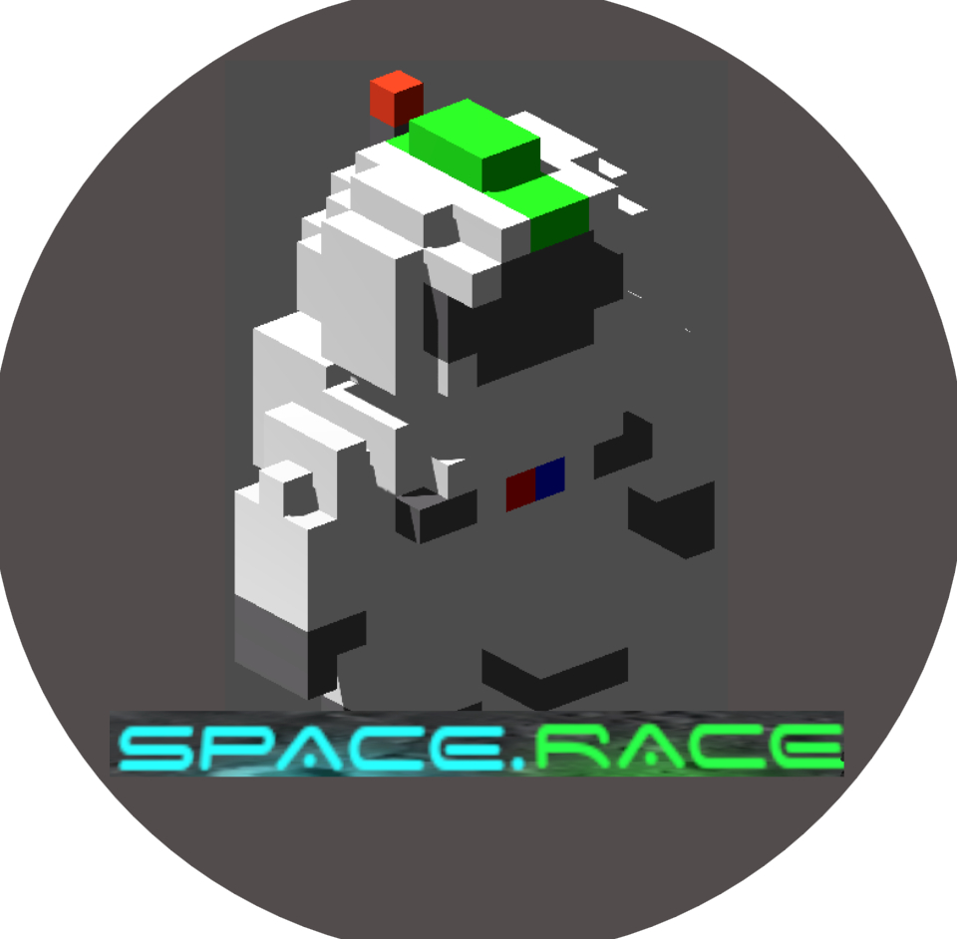
Space.Race!
Creating Your Own Game
An overview of our project
Outrun Zombies, Conquer Space! ~ Team B, 2024
Group B
Sytze (14597454), Bas (14598248), Lucas (14658887), Simon (13219715), Raven (13974920), Yifan (14614065), Owen (14621444), Michael (12405922), Ertugrul (13971832), Wessel (14445662), Tessa (14616025), Milou (14375915)

Slide 2
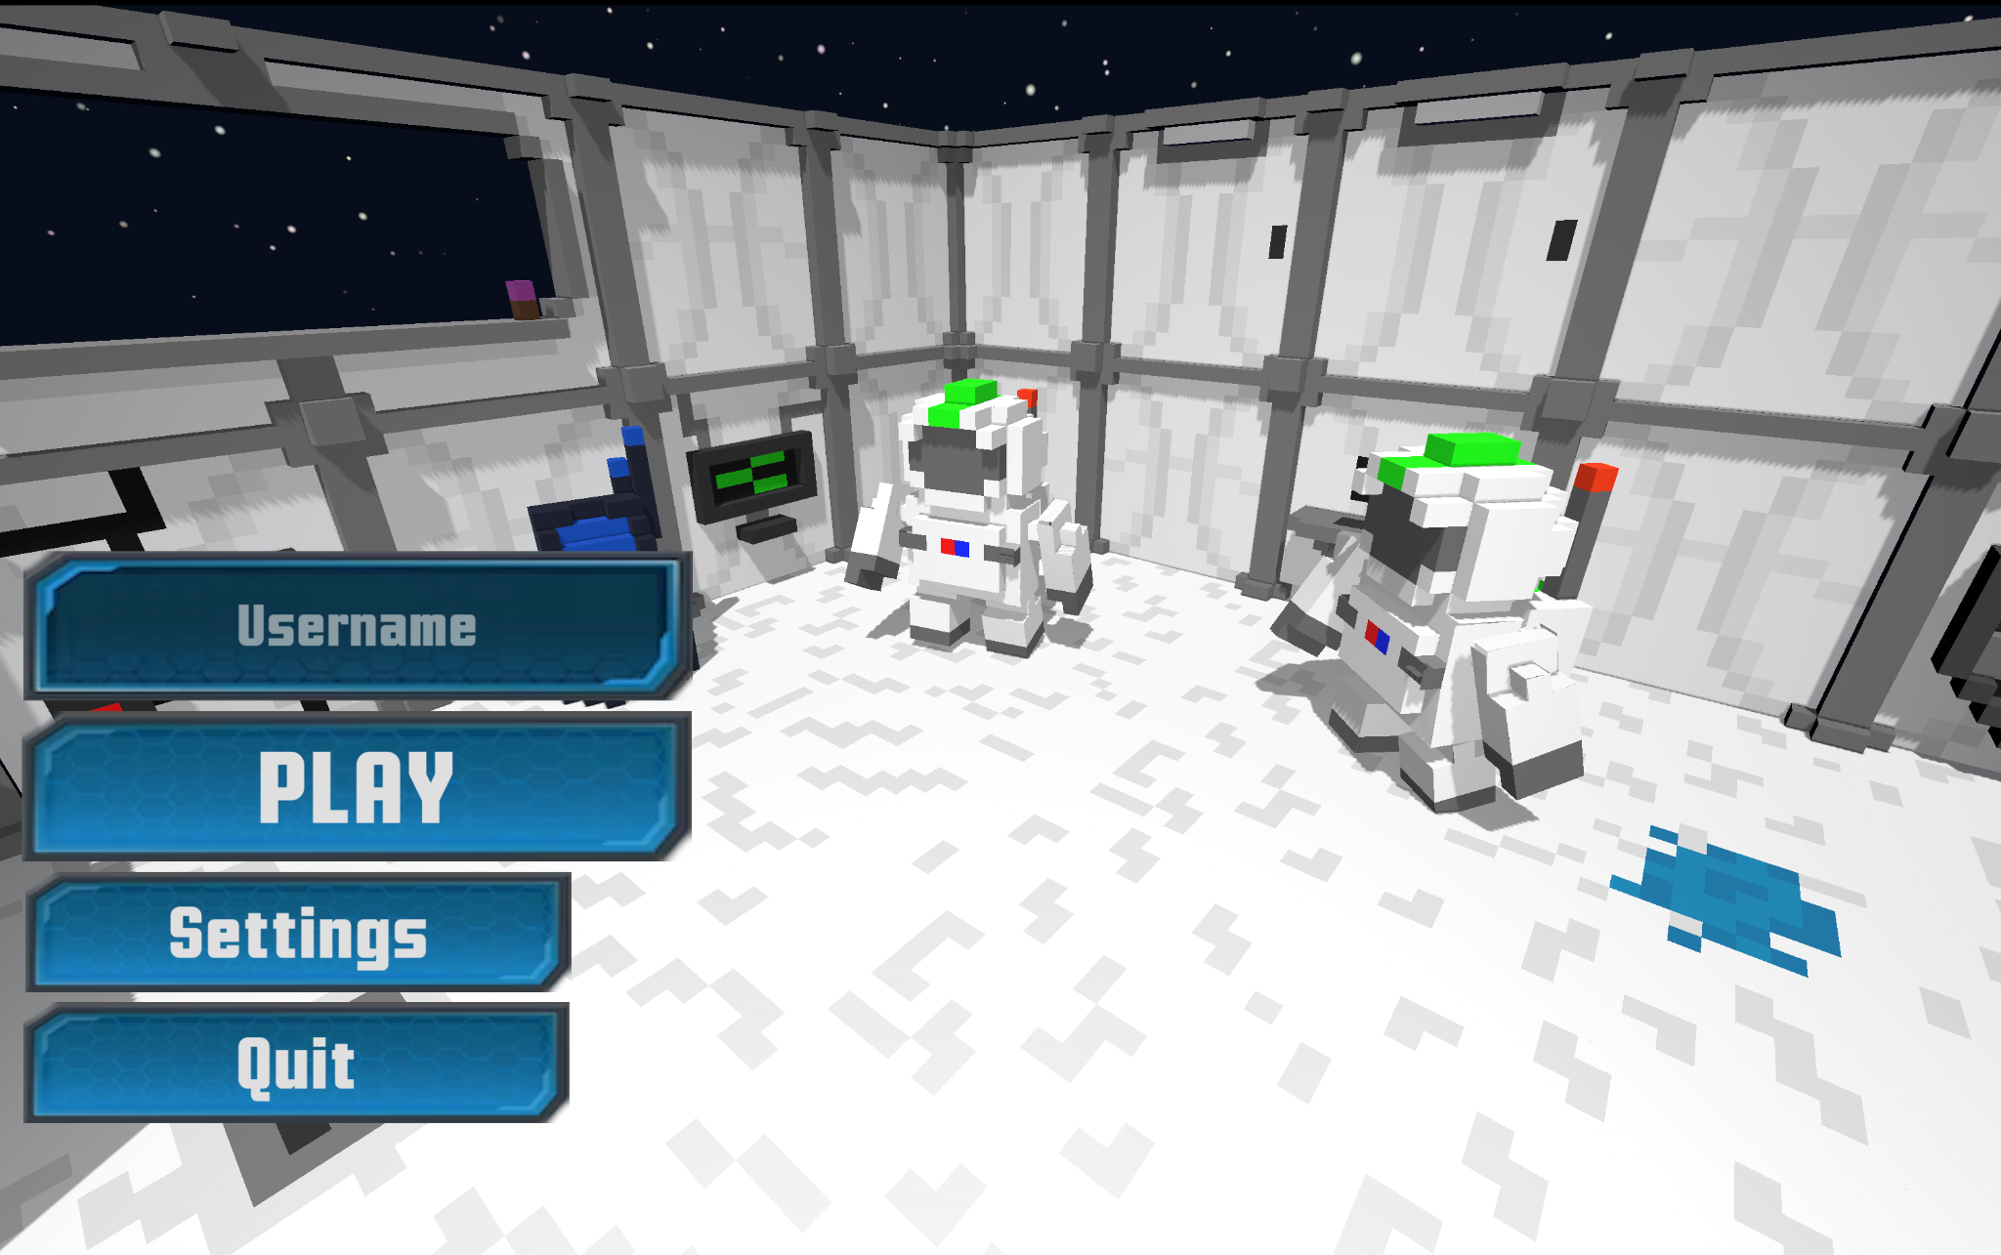
Our game
‘Space Race’
3D Game
2v2 Puzzle Race
Coordinate with your partner
Sabotage the opponent
Solve the rooms
Secure the control room!

Slide 3
Feature overview
World generation
Procedural Generation
‘Custom rooms’ editor
Random Map Script
World synchronization
Players/Enemies
Classes
Player ‘attributes’
Boss fight
Buffs
Team ‘sabotaging’
Interactables
Buttons/keys
Doors
Pressure plates
Raycast Lasers
Buffs

Slide 4
Demo

Slide 5
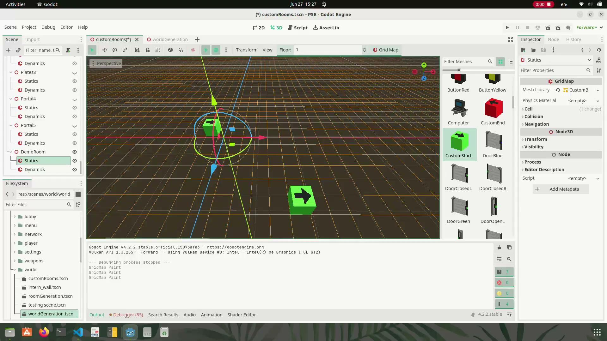
Demo CustomRooms

Slide 6
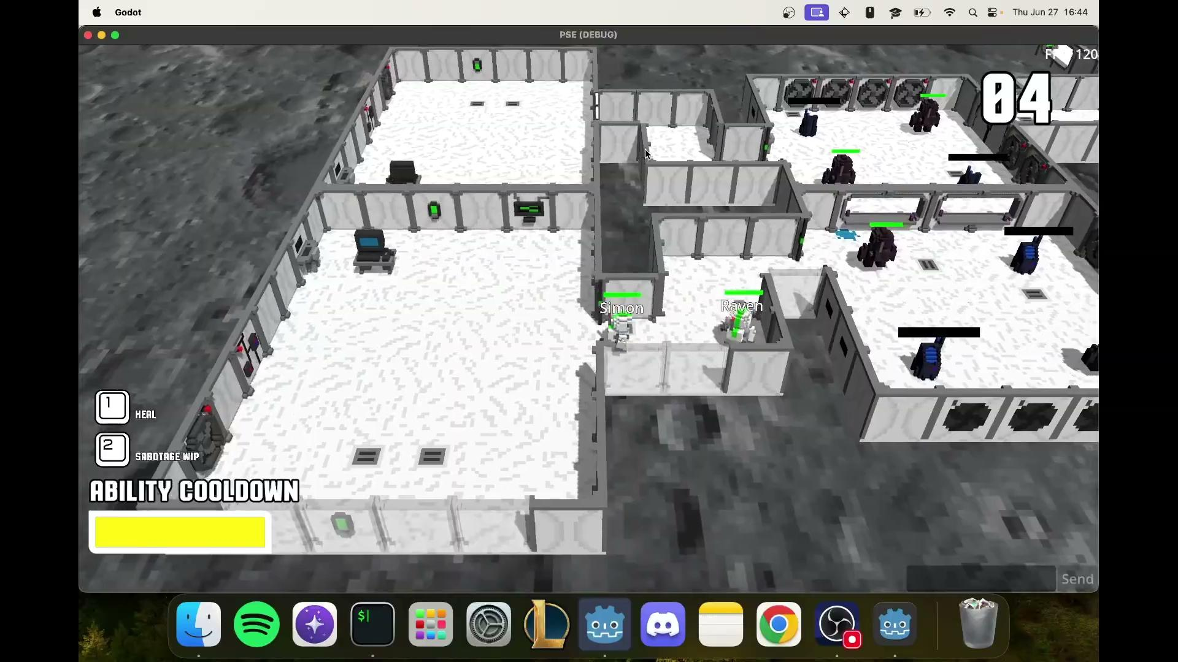
Terminal example room

Slide 7
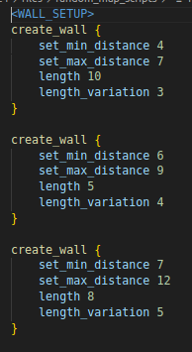
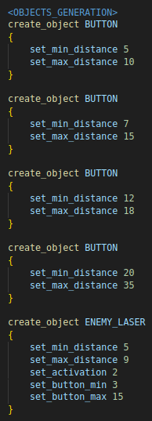
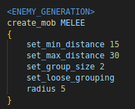
Random Map Script

Slide 8
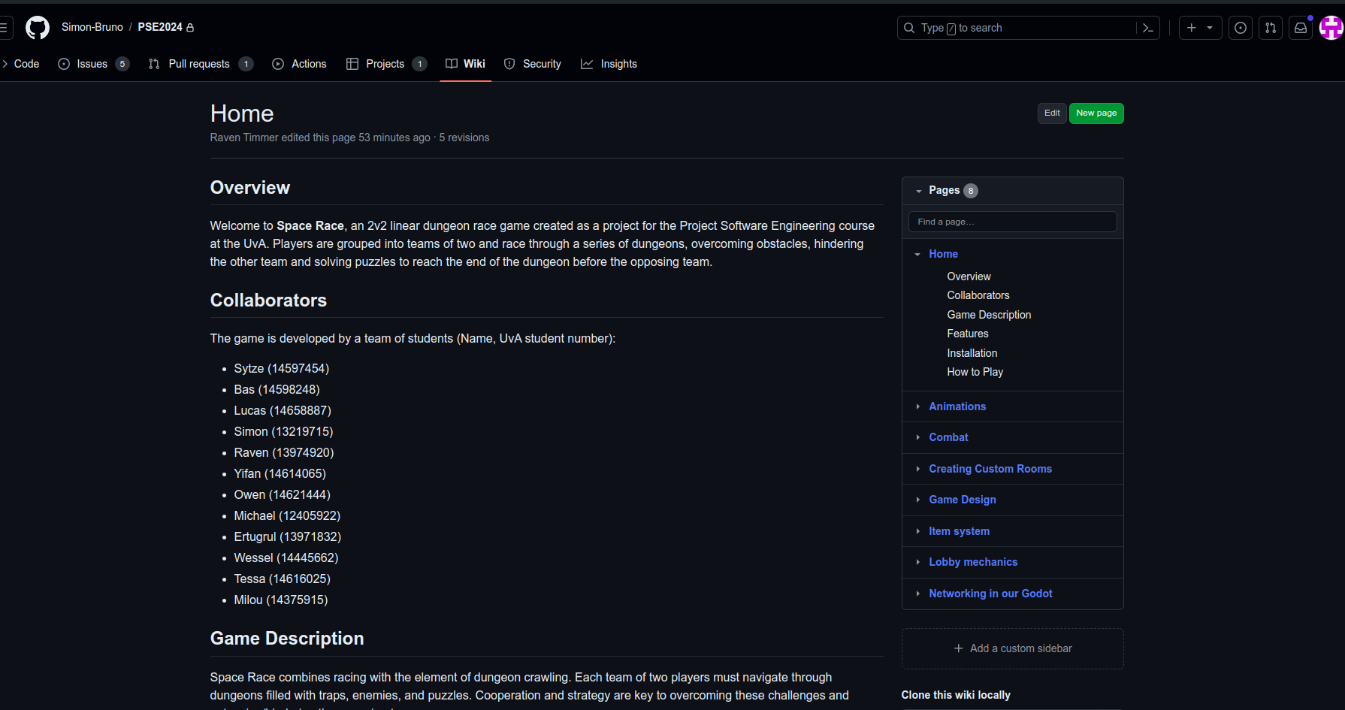
Github Wiki

Slide 9
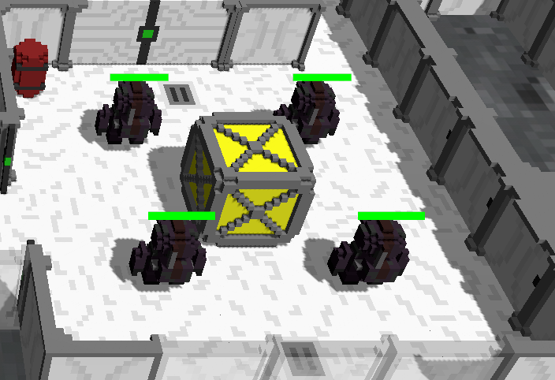
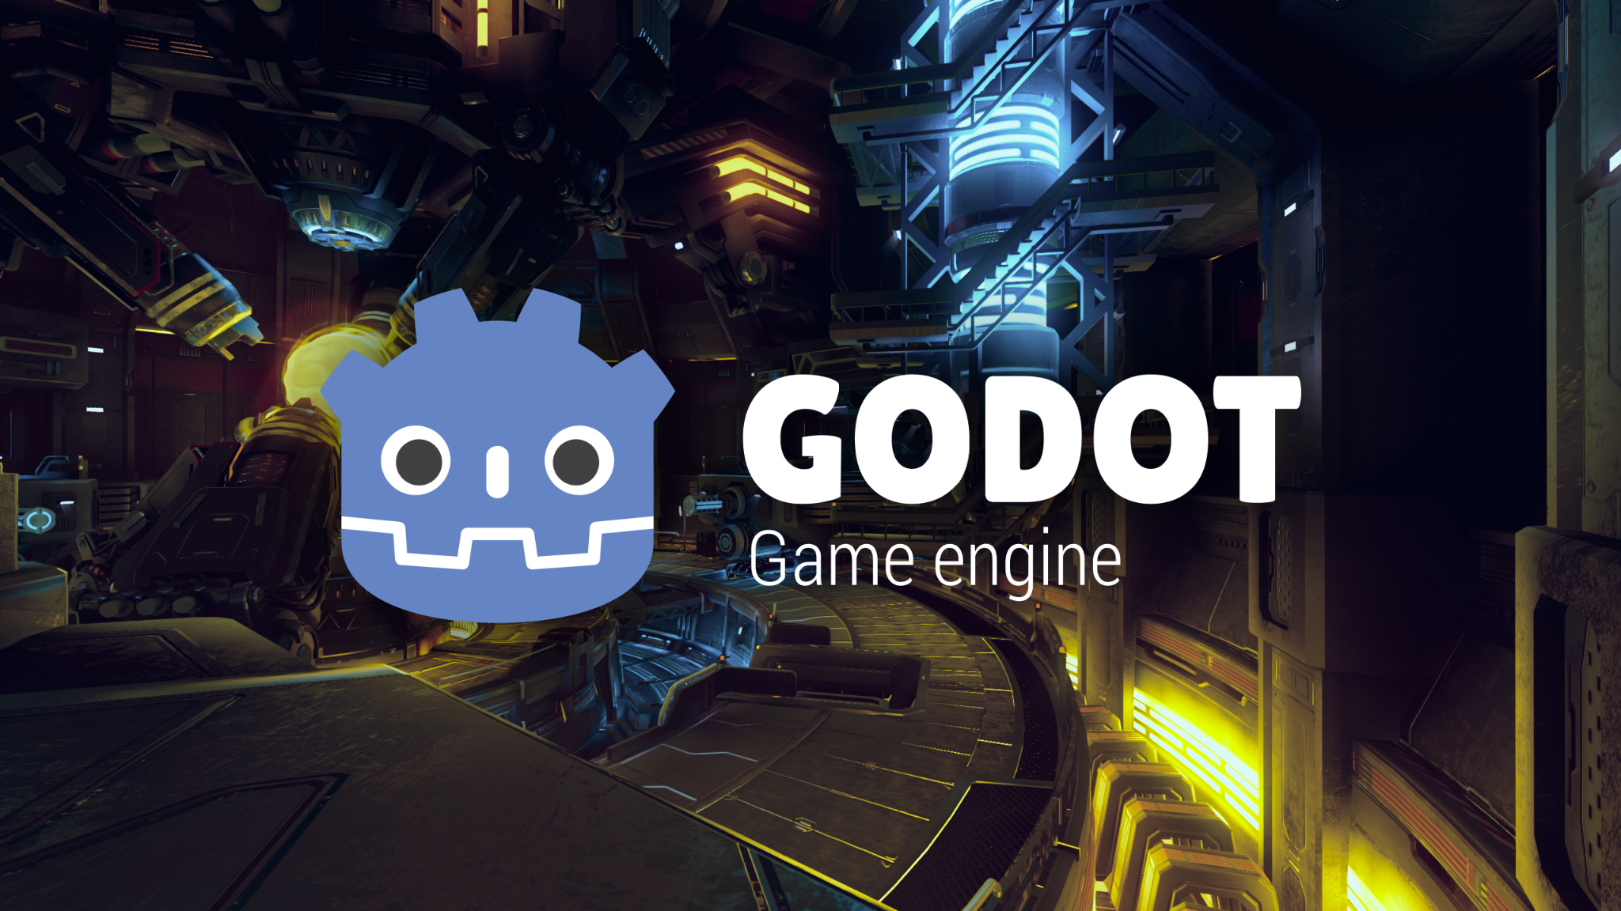
Green coding
- Godot Game Engine - LAN vs. server - Idling entities/processes

Slide 10
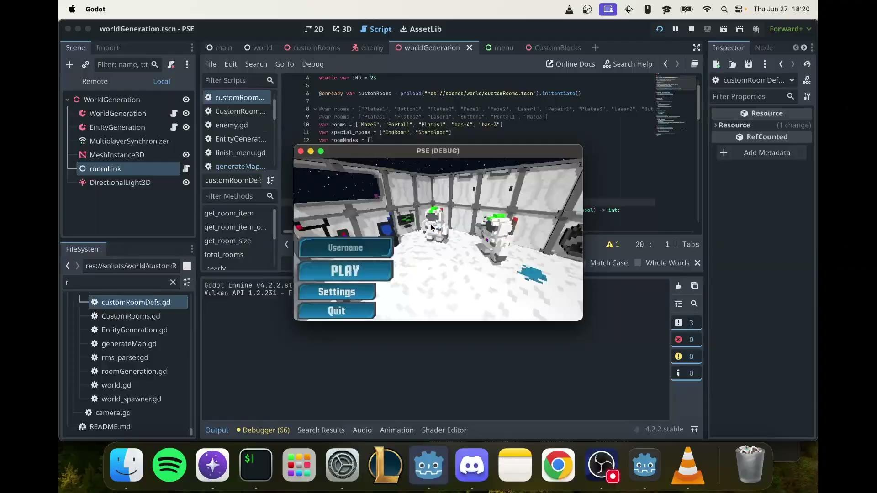
Back up video

Slide 11
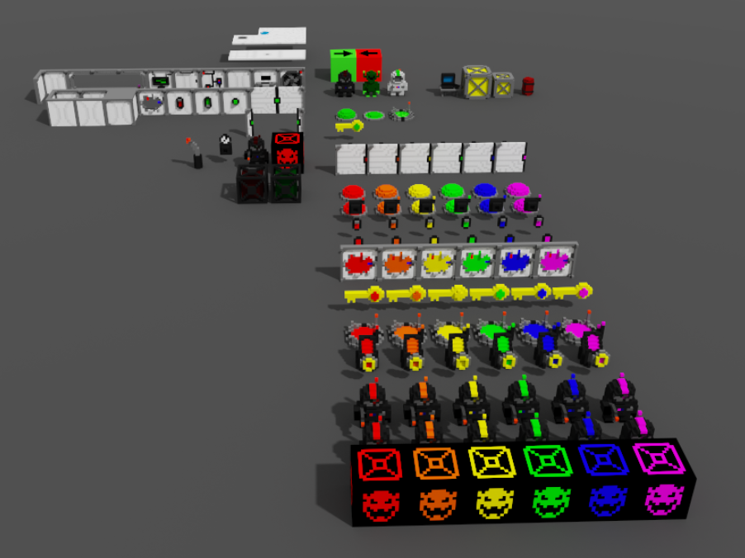
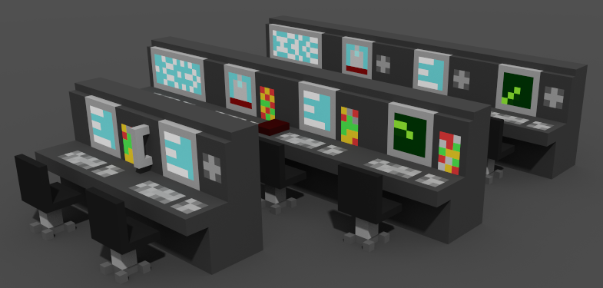
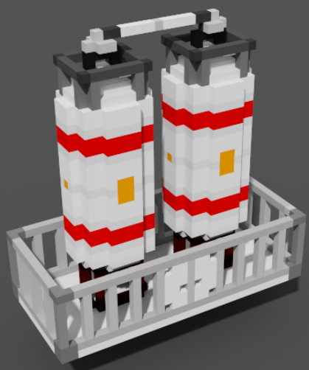
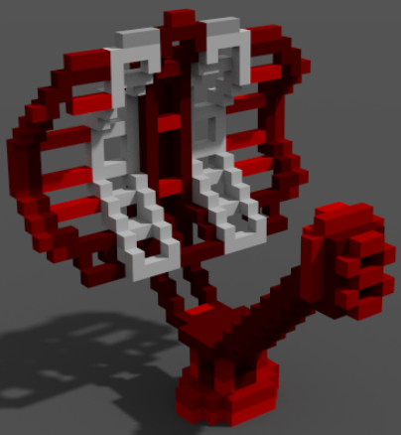
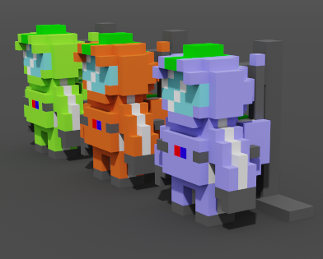
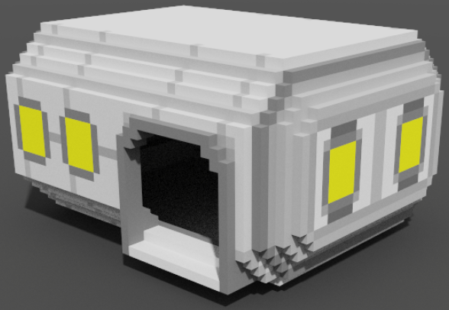
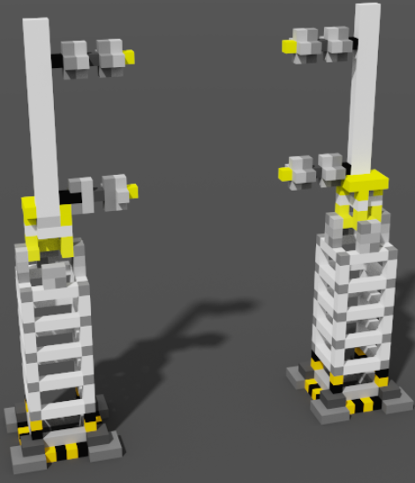
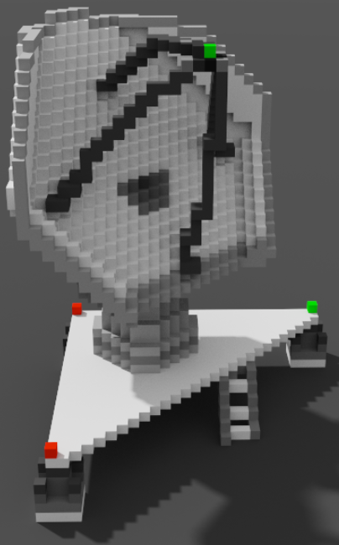
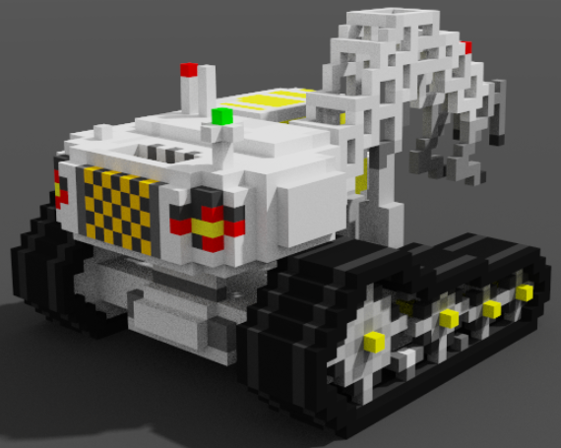
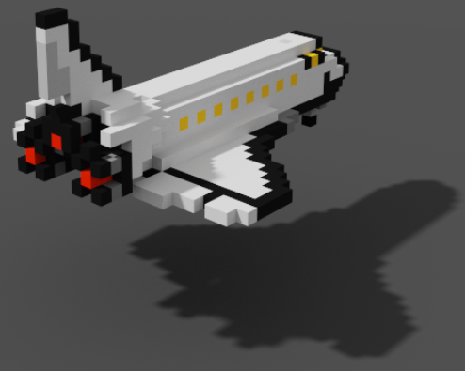
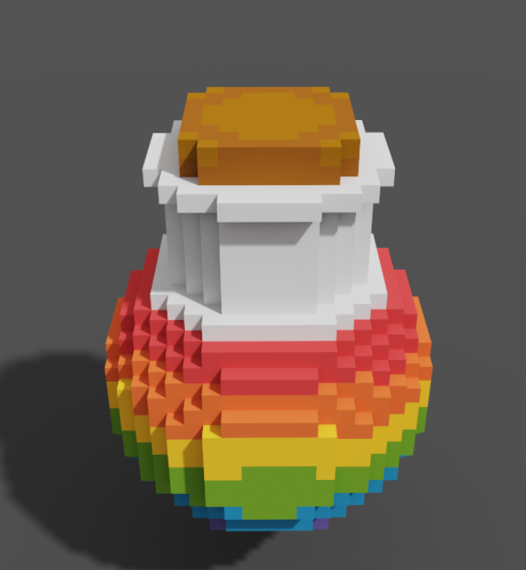
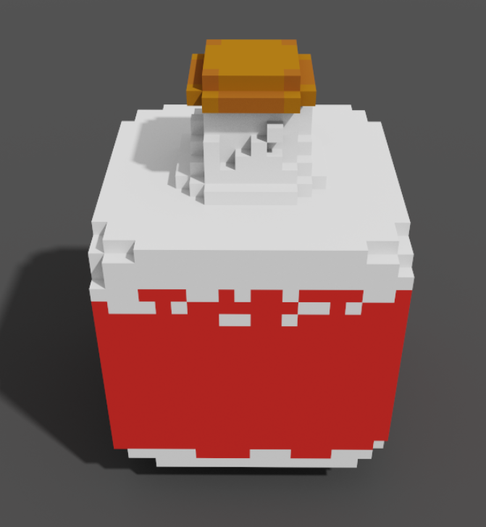
Questions?

